Slide 1




The Builder Mindset: Multi-Agent SDLC for the AI Era
From Context Engineering to Context Curation Cyber Architecture - Kishore Mooli
Notes:
Good morning, everyone. Today, we're going to talk about a fundamental shift in how we approach software development: the Builder Mindset. This isn't just about new tools; it's about a strategic re-evaluation of our entire Software Development Life Cycle, especially as AI becomes more integrated into our workflows. We'll explore how a multi-agent SDLC can help us navigate the complexities of the AI era, moving from simply managing context to actively curating it. Let's dive into the current state of AI in coding and see why this shift is so critical.

Slide 2





The AI Coding Reality Today
The Hype
The Reality
"10x Engineer in a box"
Junior Developer Level:
Infinite stamina, but zero judgment.
Instant, perfect code generation
Requires Supervision:
Needs constant code review and guidance.
Replaces entire engineering teams
Context Blindness:
Struggles to understand large, complex codebases.
"AI today is a brilliant intern. It needs a Manager (You) and a Process (SDLC) to be effective."
Notes:
So, what's the reality of AI coding today? We've all heard the hype: the 10x engineer in a box, instant code generation, entire teams replaced. But the truth is, AI today is more like a brilliant intern. It has infinite stamina, but zero judgment, and it needs constant supervision and guidance. It struggles with large, complex codebases, often exhibiting what we call 'context blindness.' We need to understand these limitations to effectively leverage AI, and that brings us to the core challenges we face.

Slide 3




Current Challenges: Why It Breaks
Context Limits
Memory Loss
Reasoning Drift
Finite token windows force aggressive summarization. Models lose track of details buried in the middle of long prompts.
Retrieval (RAG) is lossy. Summaries strip away nuance, leading to generic code that misses specific project constraints.
In complex, multi-step workflows, models lose the original goal. They "hallucinate" steps or go down rabbit holes.
Symptom
Symptom
Symptom
"Why did it forget the API change I mentioned 5 messages ago?"
"It keeps using the wrong library version despite the docs."
"It fixed the bug but broke the entire login flow."
Notes:
Building on that reality, we see three major challenges when integrating AI into our coding processes: context limits, memory loss, and reasoning drift. Models have finite token windows, which means they can easily forget details from earlier in a conversation, leading to symptoms like 'Why did it forget that API change?' Retrieval Augmented Generation, or RAG, helps, but it's still lossy; summaries strip away nuance, so the AI might use the wrong library version despite the documentation. And in complex, multi-step workflows, AI can lose sight of the original goal, leading to 'hallucinations' or breaking other parts of the system. These challenges are not just technical; they have significant market implications.

Slide 4

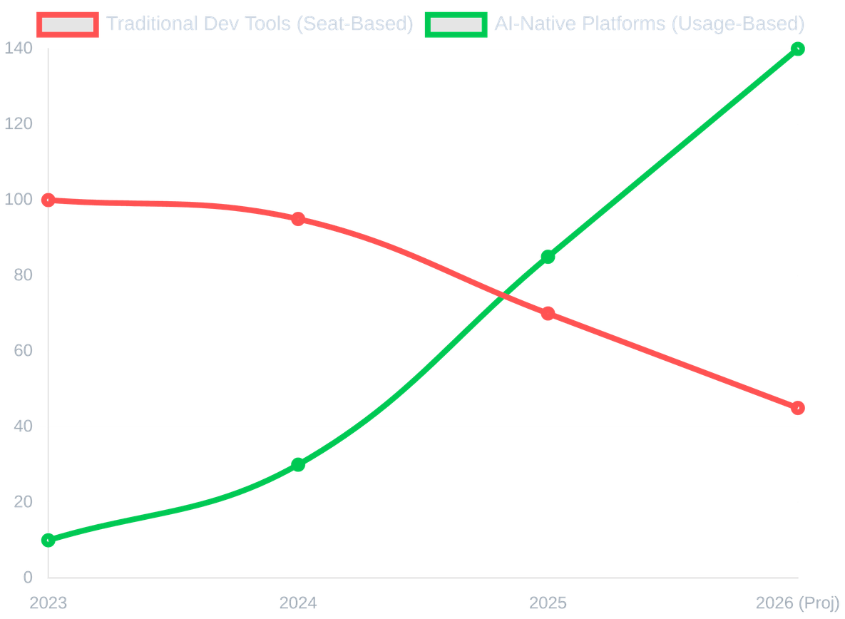


The Market Signal: Why Stocks Are Falling
Traditional "Seat-Based" SaaS Valuation
The Value Shift
Automation is destroying the "Seat Economy". Companies paying for 100 developer seats today will pay for 5 architects and 500 AI agents tomorrow.
Old Model: Selling tools to humans. Limited by headcount.
New Model: Selling outcomes to agents. Unlimited scale.
Notes:
These technical challenges are sending a clear signal to the market, and it's impacting traditional 'seat-based' SaaS valuations. The old model, selling tools to human developers, is limited by headcount. But automation is destroying that 'seat economy.' Companies that pay for 100 developer seats today will soon pay for five architects and 500 AI agents. This represents a massive value shift, moving from selling tools to humans to selling outcomes to agents, which offers unlimited scale. This shift also highlights why our traditional SDLC models are no longer sufficient.

Slide 5








Why Traditional SDLC Fails with AI
Requirements
Design
Code
Test
The Silo Problem
The Context Gap
No "Spine"
Traditional phases are disconnected. AI developers (Agents) cannot "walk over to the designer's desk" to clarify a mockup.
Information is lost at every handoff. Verbal agreements and Slack threads are invisible to the AI, leading to "hallucinated" requirements.
There is no digital thread connecting the User Story to the specific Line of Code. When the story changes, the code doesn't know.
Notes:
This brings us to why traditional SDLC models are failing in the age of AI. Our traditional phases—requirements, design, code, test—are often disconnected, creating silos. AI agents can't just 'walk over to a designer's desk' to clarify a mockup, and information is lost at every handoff. Verbal agreements and Slack threads are invisible to AI, leading to 'hallucinated' requirements. Crucially, there's no digital thread, no 'spine,' connecting a user story directly to a specific line of code. When the story changes, the code doesn't automatically know. We need a new approach, and that's what we'll explore next.

Slide 6





The Solution
SDLC Agents & The Builder Mindset
Specialization
Orchestration
Traceability
Notes:
Now that we've explored the challenges of traditional SDLC, let's dive into the solution. We're introducing a new approach that leverages the power of AI agents to transform how we build software. This section will lay out the core pillars of this solution: SDLC Agents and the Builder Mindset, focusing on specialization, orchestration, and traceability. We'll see how these elements come together to create a more efficient and reliable development process.

Slide 7




Why Sub-Agents? The Power of Specialization
The Generalist
The Specialist Team
Context Pollution:
Trying to be PM, Designer, and Coder simultaneously leads to confusion.
VS
Context Isolation:
The "SQL Agent" only sees the schema and the query request.
Shallow Reasoning:
"Jack of all trades, master of none."
Deep Expertise:
Prompts are optimized for specific tasks (e.g., "Write secure SQL").
Drift:
Forgets the original requirement as the conversation grows.
Clear Contracts:
Inputs and outputs are strictly defined (JSON/YAML).
"Smaller Context = Higher Accuracy. Divide the problem, conquer the code."
Notes:
Building on the idea of a new solution, a key component is the concept of sub-agents. We've learned that trying to make a single AI agent do everything leads to context pollution and shallow reasoning, much like a generalist trying to master too many domains. Instead, we embrace specialization, giving each sub-agent a narrow, well-defined task. This means an agent focused on SQL only sees the schema and query, leading to deep expertise and higher accuracy. This approach allows us to divide complex problems into manageable, conquerable pieces, ensuring that each part of the system is handled with precision. This specialization is crucial for scaling quality and efficiency, and it's a foundational element of the builder mindset we'll discuss next.

Slide 8




The Builder Mindset
The Coder
The Architect
"How do I write this loop?" Focus: Syntax, Libraries, Debugging lines of code.
"How does this system scale?" Focus: Requirements, Data Flow, Reviewing Agent Outputs.
"In the AI Era, code is a commodity. Architecture is the asset."
Notes:
Moving from the power of specialized agents, let's talk about the shift in mindset this enables: the Builder Mindset. In this new paradigm, the focus moves from being a coder, consumed by syntax and debugging individual lines, to becoming an architect. The architect thinks about the system as a whole, focusing on requirements, data flow, and reviewing the outputs of our agents. This is a fundamental shift because, in the AI era, code becomes a commodity. The true asset is the architecture, the intelligent design that orchestrates these specialized agents. This builder mindset is what empowers us to create robust, scalable systems, and it's essential for navigating the SDLC pipeline we'll explore next.

Slide 9





The Granular SDLC Pipeline
Spec (Definition)
Design (Architecture)
Build (Implementation)
Review (Validation)
1
1
1
BRD Generation
System Context
1
Code Review
PM & BA Agents
Architect Agent
Scaffold
Linter Agent
Define business goals, scope, and user needs.
Generate C4 diagrams (System, Container, Component).
Tech Lead Agent
Static analysis for syntax, style, and best practices.
Set up project structure and boilerplate code.
2
2
2
TRD Generation
Schema Design
2
Security Audit
Tech Lead Agent
DB Agent
Core Logic
OWASP Agent
Translate business needs into technical requirements.
Create ERD and SQL migration scripts.
Backend Agent
Scan for vulnerabilities (SQLi, XSS, etc.).
Implement business logic, services, and API routes.
3
3
3
Task Breakdown
API Contract
3
Compliance Check
Planner Agent
API Agent
UI Components
Traceability Agent
Create granular Jira tickets and sprint plan.
Define OpenAPI (Swagger) specs for all endpoints.
Frontend Agent
Verify implementation matches TRD requirements.
Build React components and integrate with API.
Notes:
With the builder mindset in place, we can now visualize the entire Multi-Agent SDLC Pipeline. This isn't just a series of steps; it's a continuous flow from an initial idea to deployment, orchestrated by specialized agents. We start with a Product Manager Agent for planning, then move to an Architect Agent for specification. Development is handled by parallel Dev Agents, followed by QA Agents for testing, and finally, a DevOps Agent for deployment. Crucially, human review gates and automated checks are integrated throughout, ensuring quality at every stage. This pipeline ensures a seamless, efficient journey for every feature, and it all begins with a strong foundation, which we'll discuss next: the BRD as the spine.

Slide 10






Step 1: BRD Creation (Definition)
1
2
3
4
5
6
7
8
BRD Create
BRD Review
Design
Plan
Dev
Test
Review
Deploy
The Squad
Orchestration Flow
Key Artifacts
Product Manager
1
Vision Statement
Draft BRD
Vision & Scope
PM defines the core problem and success metrics.
Business Requirements Document.
Business Analyst
2
Requirement Elicitation
User Personas
Requirements Gathering
BA expands vision into detailed functional reqs.
Target audience profiles.
User Story Writer
3
Story Generation
Initial Backlog
Gherkin Syntax
Writer converts reqs into User Stories (As a... I want...).
List of high-level features.

Slide 11




Step 2: BRD Review (Human Gate)
2
3
4
5
6
7
8
BRD Create
BRD Review
Design
Plan
Dev
Test
Review
Deploy
The Squad
Orchestration Flow
Key Artifacts
Business Stakeholders
1
Review Session
Approved BRD
Approval Authority
PM presents Draft BRD to stakeholders.
Finalized requirements doc.
Human Review
Product Manager
2
Feedback Loop
Presenter
Stakeholders request changes or clarifications.
Sign-off Record
Audit trail of approval.
Tech Lead
3
Approval Gate
Feasibility Check
Formal sign-off required to proceed to Design.

Slide 12





Step 3: Design Phase (Architecture)
3
4
5
6
7
8
BRD Create
BRD Review
Design
Plan
Dev
Test
Review
Deploy
The Squad
Orchestration Flow
Key Artifacts
System Architect
1
Context Definition
C4 Diagrams
Orchestrator & C4 Models
Architect defines system boundaries & containers.
System, Container & Component views.
DB Designer
2
Parallel Design
ERD Schema
Schema & Migrations
DB & API agents generate specs concurrently.
Entity Relationship Diagram & SQL.
API Designer
3
Consolidation
OpenAPI Spec
OpenAPI Contracts
Architect merges specs into master TRD.
Swagger YAML for all endpoints.
4
TRD Review Gate
Master TRD
Core team validates technical feasibility.
Full technical spec document.
Human Review

Slide 13





Step 4: Plan Phase (Strategy)
4
5
6
7
8
BRD Create
BRD Review
Design
Plan
Dev
Test
Review
Deploy
The Squad
Orchestration Flow
Key Artifacts
Planner Agent
1
Decomposition
Task.md
Task Breakdown
Planner breaks TRD into atomic tasks (Task.md).
Detailed implementation plan.
Tech Lead
2
Dependency Mapping
Jira Tickets
Estimation & Assignment
Identify blockers (e.g., API must exist before UI).
Trackable work items.
3
Sprint Allocation
Sprint Backlog
Assign tasks to Backend/Frontend agents.
Prioritized list for execution.

Slide 14






Step 5: Development (Implementation)
5
6
7
8
BRD Create
BRD Review
Design
Plan
Dev
Test
Review
Deploy
The Squad
Orchestration Flow
Key Artifacts
Tech Lead
1
Scaffold
Source Code
Scaffolding & Oversight
Tech Lead sets up repo, linting, and CI/CD.
Clean, documented codebase.
Backend Agent
2
Parallel Build
Unit Tests
API & Logic
Backend builds API; Frontend builds UI (mocked).
Jest/Pytest coverage > 80%.
Frontend Agent
3
Integration
Pull Requests
UI Components
Connect UI to real API endpoints.
Atomic commits linked to Jira.

Slide 15





Step 6: Testing Phase (System Gate)
6
7
8
BRD Create
BRD Review
Design
Plan
Dev
Test
Review
Deploy
The Squad
Orchestration Flow
Key Artifacts
QA Planner
1
Test Plan Generation
Test Plan
Strategy & Coverage
QA Planner maps User Stories to Test Cases.
Scope and strategy doc.
Test Writer
2
Execution
Execution Report
Cypress/Playwright
Run Unit, Integration, and E2E suites.
Pass/Fail metrics.
E2E Agent
3
Quality Gate
Bug Tickets
User Flow Simulation
Block release if Critical/High bugs exist.
Auto-generated Jira issues.

Slide 16






Step 7: Review Phase (Validation)
7
8
BRD Create
BRD Review
Design
Plan
Dev
Test
Review
Deploy
The Squad
Orchestration Flow
Key Artifacts
Security Auditor
1
Security Scan
Security Report
OWASP Scan
Automated vulnerability assessment (SAST/DAST).
Vulnerability assessment.
Compliance Agent
2
Compliance Audit
Compliance Matrix
Traceability Check
Verify code matches TRD requirements.
Req-to-Code mapping.
Human Reviewer
3
Final Approval
Merge Approval
Final Sign-off
Human Tech Lead merges PR to Main.
Green light for release.
Human Review

Slide 17






Step 8: Deployment Phase (Launch)
8
BRD Create
BRD Review
Design
Plan
Dev
Test
Review
Deploy
The Squad
Orchestration Flow
Key Artifacts
Release Manager
1
Provisioning
Release Notes
Go/No-Go Decision
DevOps spins up Prod environment (IaC).
Changelog for users.
DevOps Agent
2
Deployment
Live URL
Terraform & CI/CD
Blue/Green deployment strategy.
Production endpoint.
Tech Writer
3
Documentation
User Manual
User Manuals
Generate Release Notes & User Guides.
Updated help docs.

Slide 18
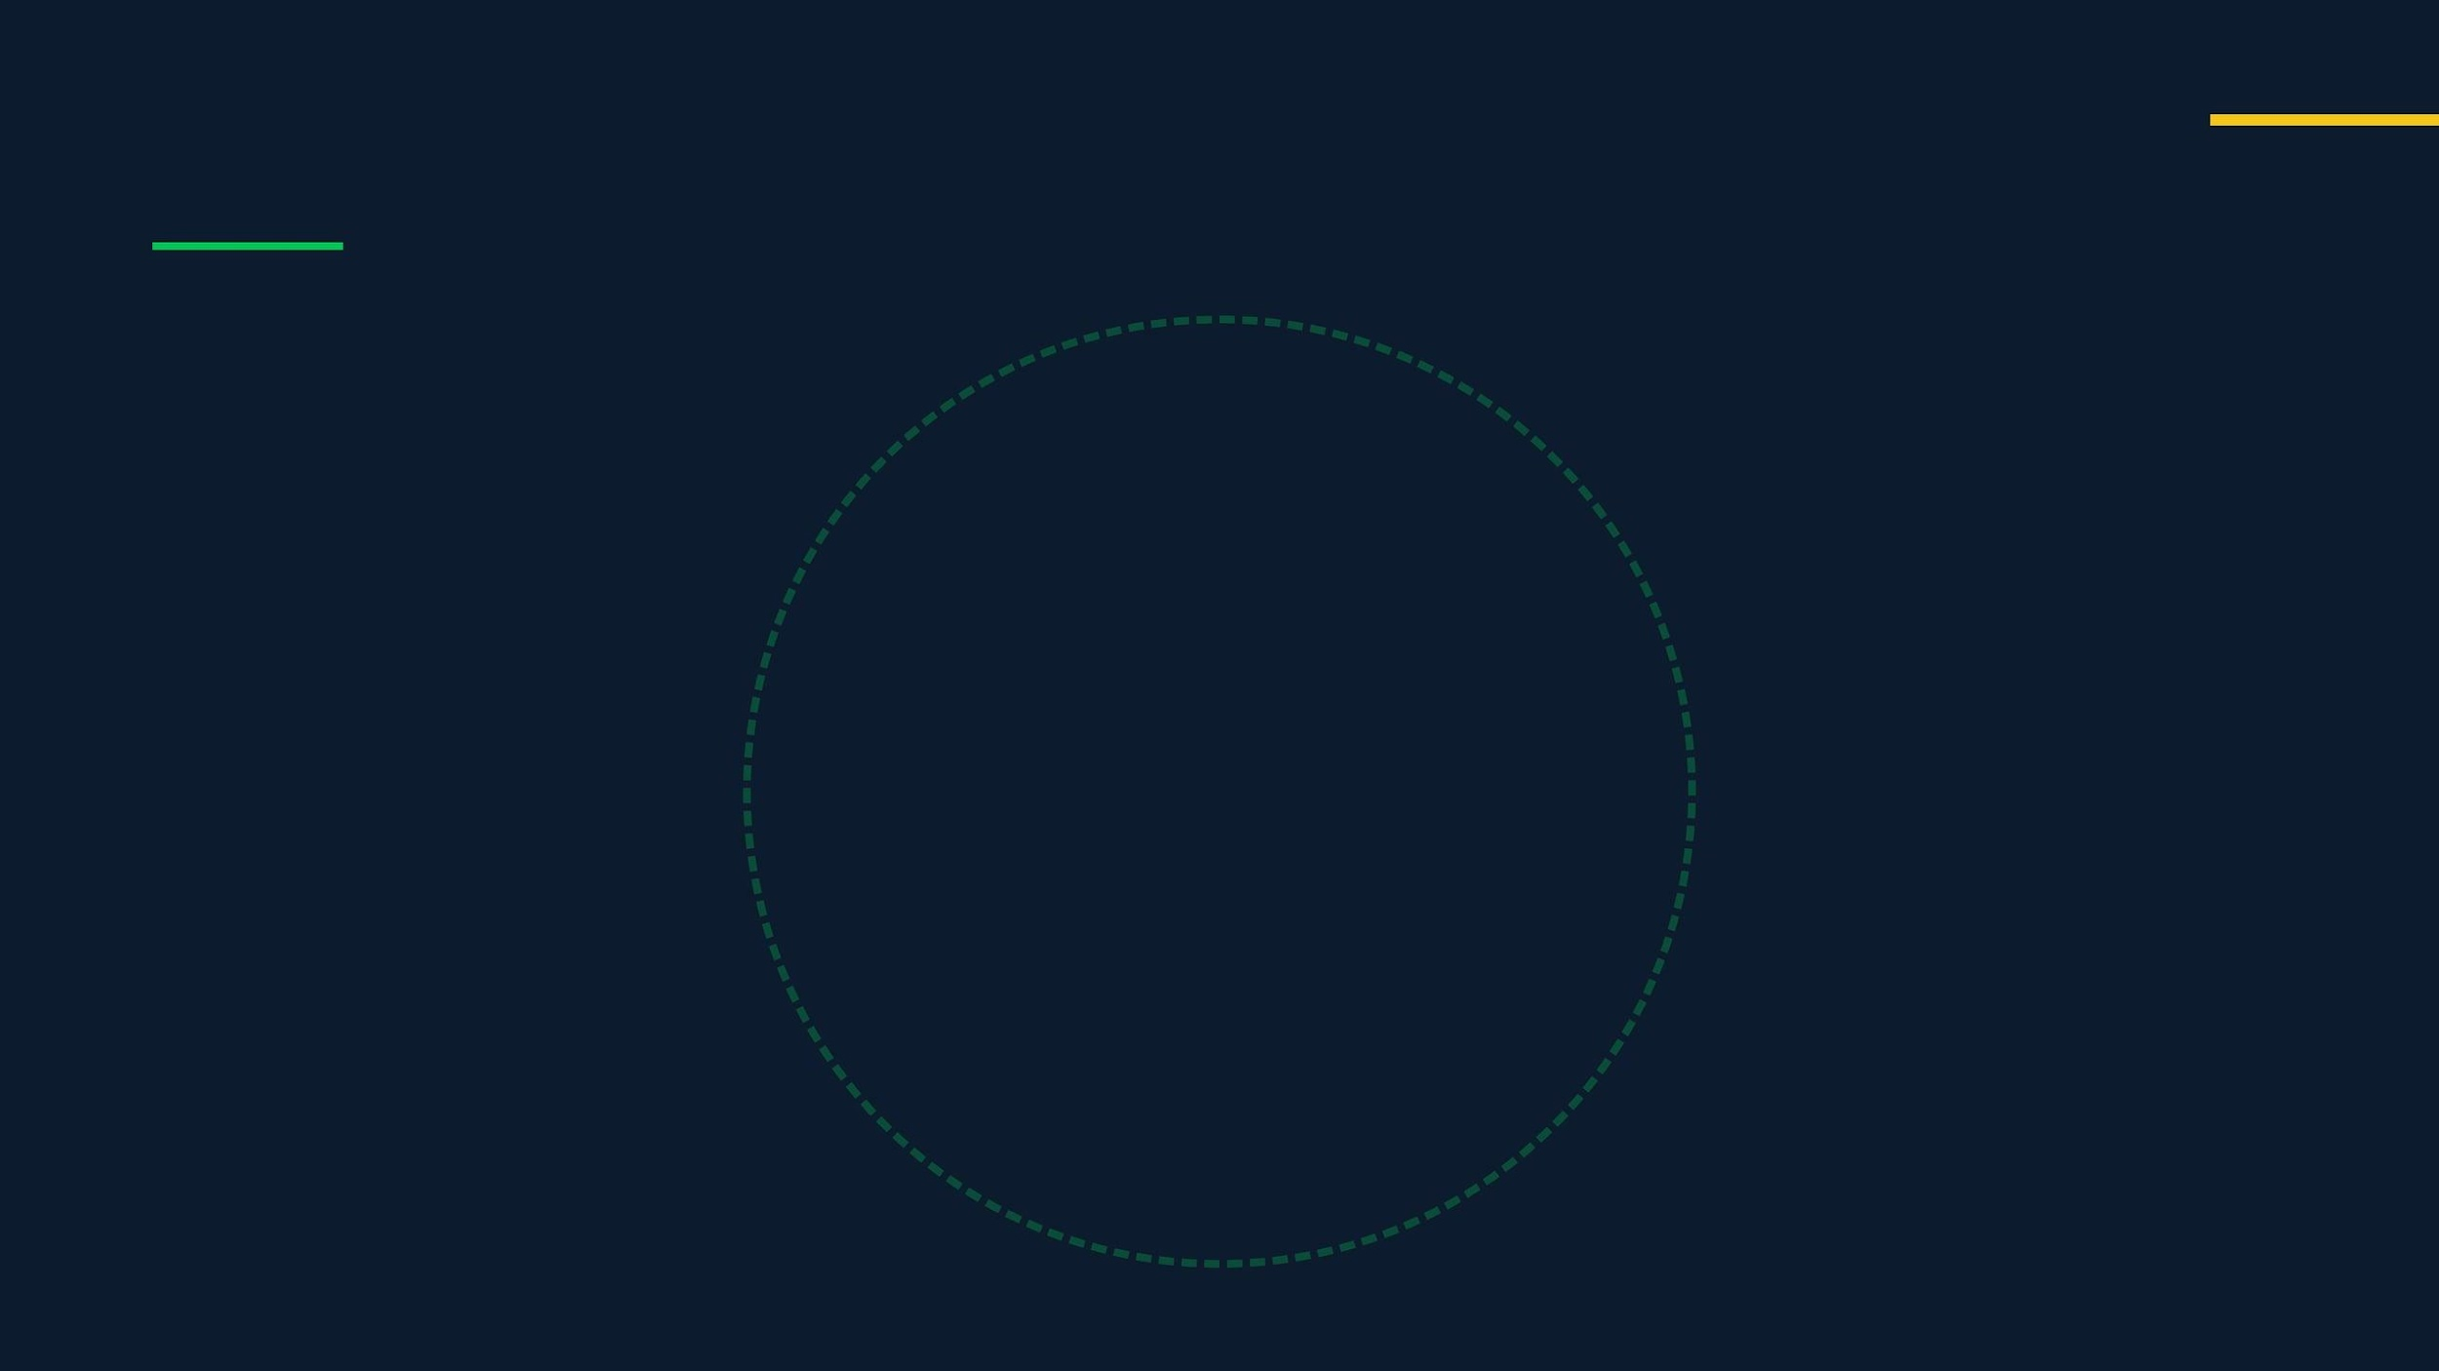




Bidirectional Sync: Keeping Docs Alive
Documentation
Test Suite
Source Code
"If the Code changes, the Docs update automatically. If the Docs change, the Tests update automatically."
Notes:
We've talked about the BRD as the central spine, but how do we ensure everything stays aligned? This is where bidirectional sync comes in, preventing what we call the documentation trap. In traditional development, documentation is often written once and then quickly becomes outdated as code evolves. Our approach ensures that if the code changes, the documentation automatically updates, and if the documentation changes, the tests are automatically updated to reflect those changes. This creates a continuous feedback loop, ensuring that your documentation, code, and tests always tell the same story. This continuous alignment is crucial for maintaining a single source of truth across the entire SDLC, eliminating drift and reducing costly errors. Now, let's look at the specialized agents that make this continuous synchronization possible.

Slide 19




The Workforce: 39+ Specialized Agents
Requirements
Design
Development
Quality
Product Manager
System Architect
Backend Dev
QA Planner
Business Analyst
DB Designer
Frontend Dev
Unit Test Writer
User Story Writer
API Designer
Integration Specialist
E2E Test Writer
Project Planner
UX/UI Designer
Migration Specialist
Security Auditor
"From Strategy to Security, every role is covered by a specialized AI agent."
Notes:
So, how do we achieve this seamless, synchronized workflow? It's through a robust roster of over 39 specialized agents, each designed to cover a specific role within the software development lifecycle. We have agents dedicated to requirements gathering, ensuring clarity and completeness from the outset. Then, a suite of design agents translates those requirements into detailed architectural and user experience specifications. Development agents then take these specifications and generate high-quality code, adhering to established standards. Finally, our quality agents rigorously test and validate every output, ensuring that what's built matches what was specified. This comprehensive coverage means that from the initial strategic vision to the final security audit, every aspect of development is handled by an expert agent. Let's dive deeper into some of these agents, starting with the requirements and planning phase.

Slide 20






Two-Layer Orchestration
Master Orchestrator
Routes User Intent (/plan, /test)
Product Lead
Design Lead
Tech Lead
QA Lead
Manages PM, Analyst, Story Writer
Manages Architect, UI/UX, DB
Manages Backend, Frontend, DevOps
Manages Unit, E2E, Security
"You talk to the Master. The Master talks to the Leads. The Leads manage the Workers."
Notes:
Now, let's talk about how we orchestrate all these specialized agents we've just discussed. Our orchestration model is split across two layers, ensuring both high-level control and granular execution. At the top, a Master Orchestrator routes user intent, acting as the central hub for commands like /plan or /test. This Master Orchestrator then delegates to various Leads—Product, Design, Tech, and QA—who manage their respective teams of agents. This structure means you interact with the Master, the Master talks to the Leads, and the Leads manage the workers, creating a clear chain of command and efficient workflow. This layered approach is crucial for maintaining control and quality, which brings us to our next point on blocking gates.

Slide 21





Quality Gates: Blocking Bad Code
Spec Gate
Design Gate
Code Gate
Deploy Gate
No ambiguous terms
Schema normalized
Linting passes
E2E tests pass
Complete user stories
API follows REST
Unit tests > 80%
Performance check
Feasibility check
Security review
No hardcoded secrets
Rollback plan ready
"If a gate fails, the pipeline stops. No bad code moves downstream."
Notes:
Building on our orchestration model, a critical component of our system is the implementation of blocking quality gates. These aren't just suggestions; they are mandatory checkpoints that prevent any substandard work from moving downstream. We have gates at every stage: for specifications, design, code, and deployment. If a gate fails, the pipeline stops immediately. This strict enforcement means we're not just hoping for quality; we're guaranteeing it at every step. This proactive approach ensures that we catch issues early, preventing them from becoming costly problems later on. But even with all this automation, human judgment remains essential, which is what we'll explore next.

Slide 22





Human-in-the-Loop: The Critical Checkpoints
Business Problem
BRD Review
Design Review
TRD Review
Stakeholder Review: "Are we solving the right problem? Is the scope clear?"
Product Manager Review: "Did the AI miss any edge cases or business rules?"
UX/UI Review: "Is the mockup intuitive? Does it match the brand?"
Tech Lead Review: "Is the schema normalized? Are the API contracts valid?"
"The AI generates the artifacts. The Human provides the judgment."
Notes:
While automation drives much of our process, human judgment remains absolutely critical, and that's where our Human-in-the-Loop checkpoints come in. These are not just reviews; they are strategic interventions where human expertise provides the ultimate validation. Whether it's a stakeholder reviewing the BRD to ensure we're solving the right problem, or a Tech Lead validating API contracts, human oversight is paramount. The AI generates the artifacts, but the human provides the judgment, ensuring that our solutions are not only technically sound but also strategically aligned and user-centric. This blend of automation and human intelligence is key to delivering truly exceptional software.

Slide 23







DevNavHub: Reusable Agent Skills
Skill Library
Stripe Payments
Auth0 Login
Secure checkout flow
OIDC Authentication
AWS Lambda
Analytics
Your Project
Serverless deploy
Mixpanel setup
Don't reinvent the wheel. Inject proven skills directly into your agent's context.
"Why write a login system from scratch? Just download the 'Auth Skill' and let the agent implement it."
Notes:
Now, let's talk about how we accelerate development even further. DevNavHub templates are all about reusability. Instead of building common functionalities from scratch, we can simply plug in proven, pre-built skill sets directly into our agents' context. This means we're not reinventing the wheel for things like payment processing or authentication. We're injecting battle-tested solutions, allowing our agents to implement them instantly. This approach drastically reduces development time and ensures consistency across projects. This concept of reusable skills directly feeds into our ability to execute multiple features in parallel.

Slide 24




Parallel Streams: Speed at Scale
Auth System
85%
Dev Agent A
Payments
60%
Dev Agent B
Dashboard
40%
Dev Agent C
"Why build sequentially? Spin up 3 agents and build 3 features at once."
Notes:
Building on the idea of reusable skills, parallel streams are how we remove bottlenecks and achieve speed at scale. Instead of a sequential process where one feature is completed before the next begins, we can spin up multiple development agents simultaneously. Each agent works on a distinct feature, like an authentication system, payments, or a dashboard, in parallel. This dramatically increases our throughput and allows us to deliver multiple features much faster. This parallel execution is a core component of how we're scaling human potential, which brings us to our next section.

Slide 25





The Future
Scaling Human Potential
100x Engineers
Infinite Context
Spec-Driven
Notes:
This brings us to Section 3, where we'll explore how Builder Mode fundamentally scales human potential. We're moving beyond incremental improvements to a paradigm shift. This section will delve into how we empower engineers to achieve 100x impact, leverage infinite context, and drive development through precise specifications. We'll examine how this new approach transforms individual contributions into a force multiplier for the entire organization.

Slide 26




The Force Multiplier: Scaling Output
100x
10x
1x
"You are no longer a bricklayer. You are the Foreman of a digital workforce."
Manual Coder
AI Assisted
Agent Orchestrator
Writes every line. 1 Feature / Week
Copilot / Chat. 10 Features / Week
Manages the swarm. 100 Features / Week
Notes:
Builder Mode truly acts as a force multiplier, fundamentally changing how we scale output. In the traditional model, a manual coder produces one feature a week. With AI assistance, that jumps to ten. But with an agent orchestrator, managing a swarm of agents, we're talking about a hundred features a week. You're no longer just a bricklayer; you become the foreman of a digital workforce, directing intelligent agents to build at an unprecedented pace. This shift in roles also demands a new approach to training, which we'll discuss next.

Slide 27






Training Your Teams: The New Curriculum
Stop
Start
Accelerate
Memorizing Syntax
System Design (C4)
Agent Debugging
Rote LeetCode Drills
Prompt Engineering
Architecture Patterns
Manual Boilerplate
High-Level Code Review
Spec Writing
"Shift focus from How to code (Syntax) to What to code (Architecture)."
Notes:
This new paradigm requires a new curriculum for our developers. We need to stop focusing on rote memorization of syntax or endless LeetCode drills. Instead, we're shifting our focus to system design, prompt engineering, and high-level code review. We'll accelerate skills like agent debugging, understanding architecture patterns, and mastering spec writing. The goal is to move from 'how' to code to 'what' to code, empowering our teams to think strategically and leverage these powerful tools effectively.

Slide 28








LLM Challenges: The Road Ahead
Today: Scarcity
Tomorrow: Abundance
Limited Context
Infinite Context
"Lost in the Middle" phenomenon.
1M+ Tokens. Perfect Recall.
Reasoning Drift
System 2 Thinking
Hallucinations in long chains.
Self-correcting logic loops.
Fragmented RAG
Graph Memory
Lossy retrieval of docs.
Holistic project understanding.
"The bottleneck shifts from Memory to Specification Accuracy."
Notes:
We've talked about how we're training our developers, but what about the underlying technology? We're all aware of the current limitations of large language models, things like limited context windows and the "lost in the middle" phenomenon. We also see reasoning drift and hallucinations, especially in longer chains, and fragmented RAG leading to lossy retrieval. But this is changing rapidly. We're moving towards a future of abundance with infinite context, perfect recall, and self-correcting logic loops. This means the bottleneck shifts from memory to specification accuracy. So, what does this mean for the next 18 months?

Slide 29




What's Next: The 12-Month Horizon
Now (Q1/2 2026)
Next (Q3/4 2026)
Future (2027+)
Integrate Agentic workflows into Development
Integrate Agentic workflows for quality gates/release workflows
Self-Healing Systems
"The goal is not to replace developers, but to elevate them to System Architects."
Notes:
The next 18 months will truly change everything. Right now, we're focused on context engineering, managing RAG pipelines, and strict prompt engineering to overcome current limitations. But very soon, we'll see agentic IDEs that proactively suggest architectural changes, not just code completion. Looking further out, we're heading towards self-healing systems that detect bugs, write tests, fix code, and deploy without human intervention. The goal isn't to replace developers; it's to elevate them to system architects. But how do we measure success in this new paradigm?

Slide 30






Innovations & Success Metrics
Innovations enabling builder mindset
Success Metrics (DORA)
Reasoning Models (o1)
4x
-60%
"Thinking" before coding reduces logic errors by 40%.
Deploy Frequency
Change Failure Rate
Elite Performers
Fewer Bugs
Repo-Level Context
Agents now understand the entire codebase, not just
80%
2x
one file.
Code Generated
Dev Satisfaction
Agentic IDEs
AI Contribution
Less Boilerplate
Tools like Cursor/Windsurf integrate agents directly
into the editor.
"Measure what matters: Velocity and Stability. AI improves both."
Notes:
Measuring success in this new world means focusing on key innovations and metrics. We're seeing reasoning models that reduce logic errors by 40% and agents that understand the entire codebase, not just single files. Agentic IDEs are already integrating these capabilities directly into our editors. When we look at DORA metrics, we're seeing a 4x increase in deploy frequency, a 60% reduction in change failure rates, and 80% of code being generated by AI. This also leads to a 2x increase in developer satisfaction. Ultimately, we're measuring what matters: velocity and stability, and AI is improving both.

Slide 31
Thank you
Questions?
Notes:
Good morning, everyone. Today, we're going to talk about a fundamental shift in how we approach software development: the Builder Mindset. This isn't just about new tools; it's about a strategic re-evaluation of our entire Software Development Life Cycle, especially as AI becomes more integrated into our workflows. We'll explore how a multi-agent SDLC can help us navigate the complexities of the AI era, moving from simply managing context to actively curating it. Let's dive into the current state of AI in coding and see why this shift is so critical.

Slide 32





The BRD Spine: The Source of Truth
Persona
"As a Premium User..."
User Story
"...I want to download reports so I can analyze offline."
Traceability: Every line of code is linked back to a specific User Story. If the Story changes, the Agent knows exactly which code to update.
Technical Spec
"GET /api/v1/reports/download (PDF/CSV)"
Implementation
Python/FastAPI endpoint + Unit Tests
Notes:
The core of our pipeline, and indeed the entire Builder Mode approach, is the Business Requirements Document, or BRD. We see the BRD as the spine of everything we build. It starts with defining the persona, like 'As a Premium User,' then moves to the user story, 'I want to download reports so I can analyze offline.' This directly informs the technical specification, such as 'GET /api/v1/reports/download (PDF/CSV),' and ultimately the implementation, like a Python/FastAPI endpoint with unit tests. This creates full traceability, meaning every line of code is linked back to a specific user story. If that story changes, our agents know exactly which code needs updating, ensuring consistency and preventing drift. This continuous alignment is key to preventing the documentation trap, which we'll discuss next.

Slide 33









Requirements Phase: The Foundation
The Squad
Sequential Handoff
Key Artifacts
1
Epic Definition
Product Manager
PRD
Vision & Roadmap
PM defines high-level goal & scope.
Product Requirements Document with goals & KPIs.
2
BRD Generation
Business Analyst
BA expands to full requirements & edge cases.
BRD
Detailed Requirements
Business Requirements with acceptance criteria.
3
Human Review
Human BRD Review
User Story Writer
Stakeholders validate completeness before proceeding.
Jira / Gherkin Specs
User Stories
Gherkin scenarios & Jira tickets.
4
Story Breakdown
Project Planner
Sprint Plan
Timeline & Sprints
Writer converts to Gherkin/Jira tickets.
Prioritized backlog with effort estimates.
Notes:
Building on the idea of specialized agents, let's look at the Requirements Phase, which is truly the foundation of everything we build. Here, we have a dedicated squad of agents: the Product Manager, Business Analyst, User Story Writer, and Project Planner. Each agent plays a critical role in a sequential handoff, ensuring that every detail is captured and validated. The Product Manager defines the high-level goals, which the Business Analyst then expands into detailed requirements and edge cases. The User Story Writer translates these into actionable Gherkin scenarios and Jira tickets, and the Project Planner creates the timeline and sprint plan. This structured approach ensures that our key artifacts—the PRD, BRD, user stories, and sprint plan—are robust and thoroughly reviewed by humans before development even begins. This meticulous planning sets the stage for the subsequent design phase, which we'll explore next.

Slide 34









Design Phase: Parallel Architecture
The Squad
Fan-Out / Fan-In
Key Artifacts
Architect: System Context (C4)
System Architect
C4 Architecture
Lead Designer
System, Container & Component diagrams.
DB Agent
API Agent
UX Agent
Human Review
DB Designer
ERD & Schema
Swagger Spec
Wireframes
Schema & SQL
ERD / SQL Schema
Human Review:
Architect + Team validate all artifacts
Entity relationships & migration scripts.
before dev starts.
API Designer
OpenAPI Spec
OpenAPI Specs
Swagger YAML with all endpoints defined.
UX/UI Designer
UI Wireframes
Wireframes & Style
Lo-fi mockups & CSS design tokens.
Human Review
Notes:
Following the rigorous requirements phase, we move into the Design Phase, where our agents work in parallel to create a comprehensive architectural blueprint. Here, the System Architect leads the charge, coordinating with the DB Designer, API Designer, and UX/UI Designer. This phase operates on a 'fan-out, fan-in' model: the Architect establishes the system context using C4 diagrams, while the DB Agent generates the ERD and schema, the API Agent defines the OpenAPI specifications, and the UX Agent creates wireframes. This parallel execution allows for rapid and comprehensive design, with all artifacts—C4 architecture, ERD, OpenAPI specs, and UI wireframes—undergoing human review by the architect and the team. This ensures that all design elements are validated and aligned before any coding begins, providing a solid foundation for the development phase.

Slide 35









Development Phase: Layered Build
The Squad
Key Artifacts
Tech Lead
TRD
TRD & Task Breakdown
Technical Requirements Document with task breakdown.
Human Review
Backend Developer
Core Logic & API
Bottom-Up Build
Source Code
Git commits with conventional messages.
TRD Review:
Core team validates technical spec before
Frontend Developer
coding begins.
UI Components
Live API Endpoints
Deployed Swagger UI with working routes.
3
Frontend Integration
Integration Specialist
UI connects to live API endpoints.
3rd Party APIs
Unit Test Suite
2
Business Logic & API
Pytest/Jest with 80%+ coverage report.
Routes, controllers & service layer.
1
Database & Models
Schema, ORM models & migrations.
Notes:
Once the design is solidified, we enter the Development Phase, where our agents focus on a layered, bottom-up build approach. The Tech Lead agent oversees the creation of the Technical Requirements Document and task breakdown, ensuring clarity for the development team. Then, the Backend Developer, Frontend Developer, and Integration Specialist agents work in concert. We start with the database and models, followed by the business logic and API, and finally, the frontend integration. This structured approach ensures that each layer is built upon a stable foundation. Crucially, the TRD undergoes a core team review before any coding starts, and all source code, live API endpoints, and unit test suites are meticulously tracked and validated. This disciplined approach ensures high-quality code that aligns perfectly with our specifications, preparing us for the critical quality and security checks.

Slide 36












Quality Phase: The Gauntlet
The Squad
Key Artifacts
QA Planner
Test Plan
Test Strategy
QA strategy, scope & test scenarios.
Blocking Gates
Unit Test Writer
Coverage Report
Code Coverage
Unit Testing
HTML report with line-by-line coverage.
Pytest/Jest — 80%+ coverage required.
Target: 80%+
E2E Test Writer
E2E Test Report
User Flow Automation
E2E Validation
Playwright HTML report with screenshots.
Playwright simulates full user journeys.
Security Auditor
Security Audit Report
Vulnerability Scan
Security Audit
OWASP findings with severity ratings.
OWASP scan — zero critical findings to pass.
0 Critical Findings
Notes:
Moving into the Quality Phase, we see a dedicated squad of agents focused on ensuring the integrity of our software. This isn't just about finding bugs; it's about building quality in from the start. We have agents for test strategy, unit test writing, and even E2E test writing, all working to create a robust testing pyramid. This comprehensive approach means we're catching issues early, rather than letting them fester. The key artifacts here, like the Test Plan and Coverage Report, provide clear, measurable indicators of our quality posture. This leads us directly into the next set of specialized agents that handle operations and release.

Slide 37






Specialized Phase: Ops & Release
The Squad
Key Artifacts
DevOps Engineer
Continuous Loop
CI/CD Pipeline
CI/CD & Infra
GitHub Actions YAML with build & deploy stages.
1
Provisioning
Release Manager
DevOps updates Terraform & Docker configs.
Release Notes
Deployment
Auto-generated CHANGELOG from commits.
2
Deployment
Release Manager approves & triggers prod push.
API Documentation
Tech Writer
Docusaurus / Confluence pages auto-updated.
Documentation
Documentation
3
Tech Writer auto-updates Wiki & API Docs.
Bug Reports
Support Agent
Jira tickets auto-created from user feedback.
Feedback Loop
4
Feedback Loop
Support logs issues as new Jira tickets.
Cycle repeats each sprint
Notes:
Following our quality checks, the Specialized Phase brings in agents focused on operations and release, completing the continuous loop of our SDLC. Here, a dedicated squad of DevOps engineers, release managers, and technical writers ensures that our software is not only built well but also deployed efficiently and documented thoroughly. This continuous loop, from provisioning to deployment and then back into the feedback cycle, means we're constantly refining and improving. The artifacts, like the CI/CD Pipeline and auto-generated Release Notes, are critical for maintaining agility and transparency. Now, let's zoom out a bit and look at how all these agents are orchestrated.

